Slide 1

MONEY TALKS!

Slide 2
What I will cover today
How to discuss FHA, VA, & CONV financing with the customer and the characteristics of each loan type
How to present and make adjustments to financial scenarios for accuracy.
  Interest Rate
  Tax Prorations
  Interest Prorations
  Credits for closing costs
  Adjustments for VA Funding Fees
Determine the buyer’s debt to income ratios
Demonstrate the tax benefits of home ownership
Reduce your dependency on outside lenders
Close for the SALE TODAY!
Notes:
Tools for competently discussing financing with customer. From management perspective, empowers your sales people, no reliance on OSL, no time delay, reduces risk of the buying elsewhere.

Slide 3
Why should we Talk Money?
Gives us credibility as a trusted advisor
Offers the ability to overcome financing objections
Shows the buyer how much the home will cost
Sets expectations
Allows us to understand the buyers challenges
Helps us set goals for the customer
Allows us to Close the sale TODAY rather than create a delay sending buyers to a lender for qualification
IT EMPOWERS US TO SELL MORE HOMES
Notes:
Add effect here animation? Each bullet comes in one at a time on my click.

Slide 4
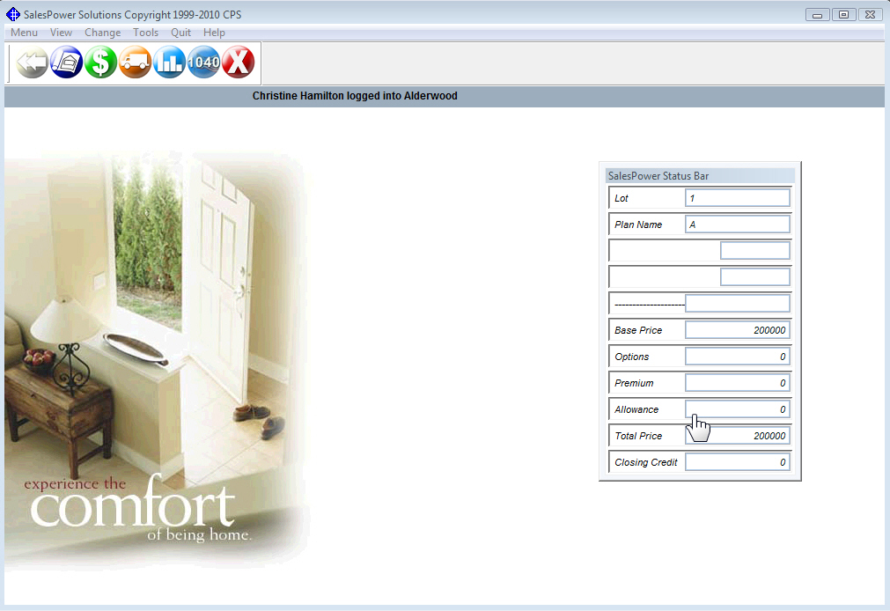
Using SalesPower Solutions
Notes:
Add effect here animation? Each bullet comes in one at a time on my click.
4

Slide 5
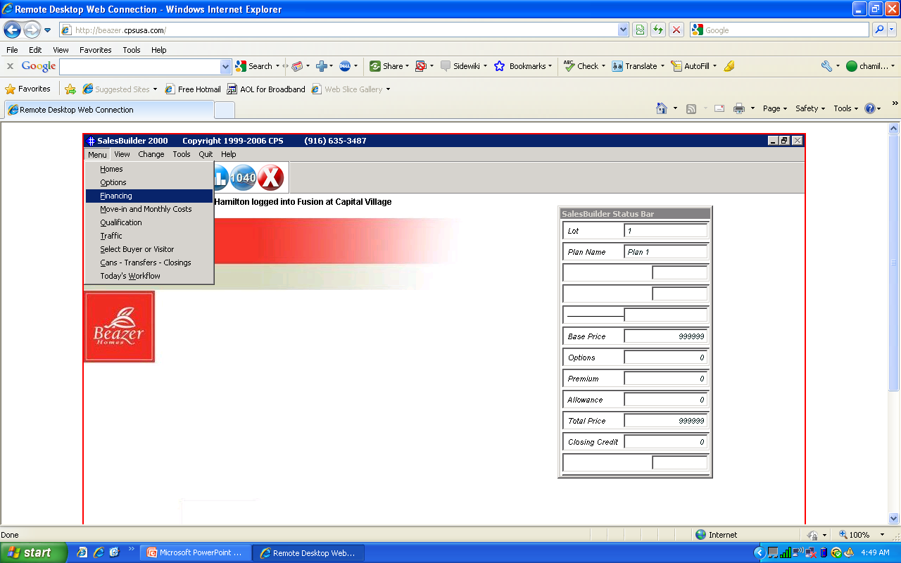
Notes:
From the drop down menu we are only going to go over 3 things in our Webinar. The first will be Financing as you see highlighted. The second will be Move-in and Monthly Costs just below financing. Last will be Qualification. We will use Financing to choose which loan(s) we are going to present to the buyer. We will use the Move-in and Monthly screen to discuss the loan with the buyer. And last, we will use the Qualification section to run their Debt to Income Ratios and determine their ability to qualify for the loan.

Slide 6
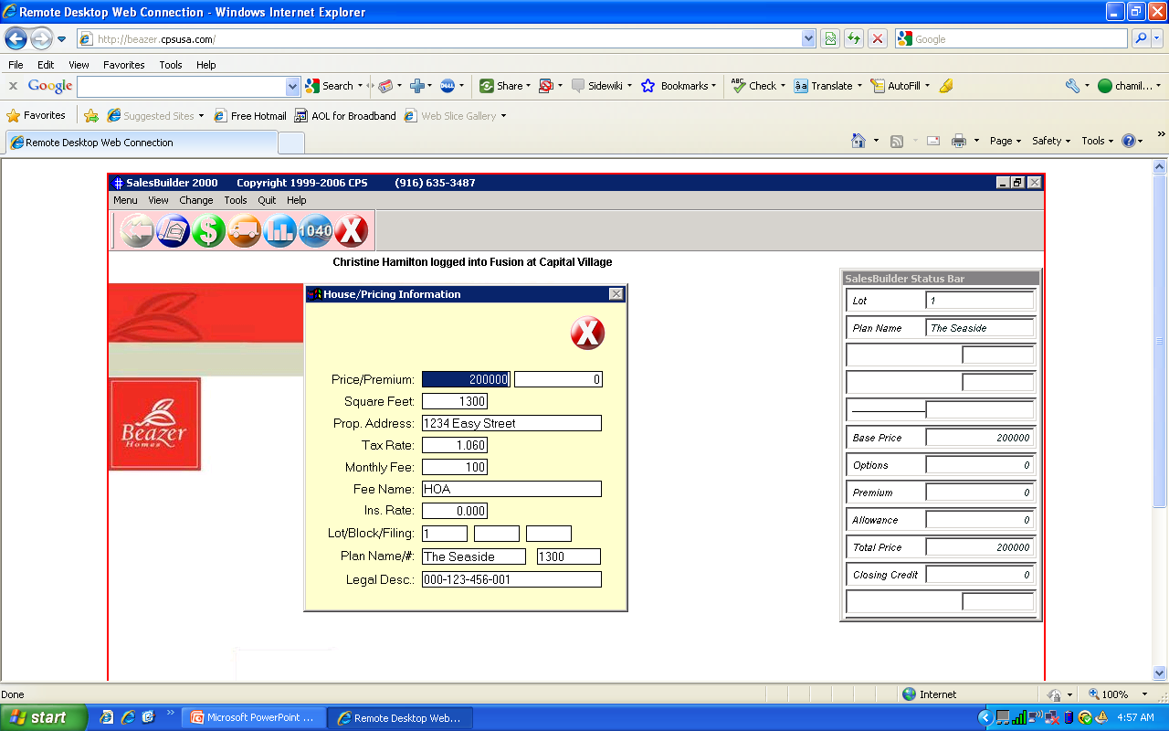

Slide 7
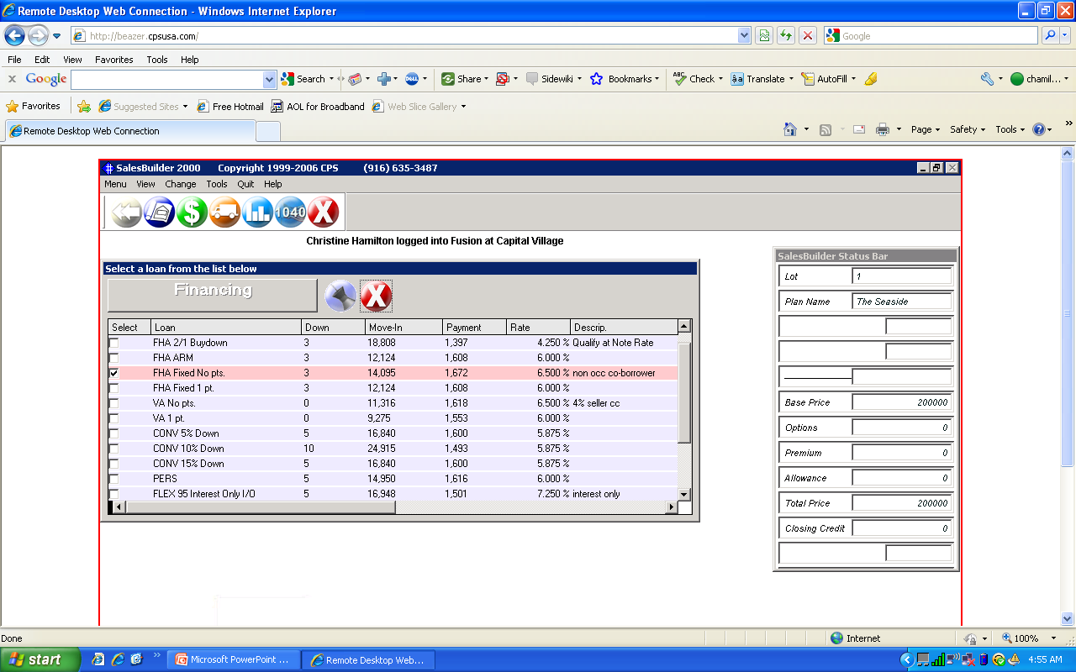
Notes:
Notice all of my loan are set up here. Sales Manager, Administrator or Lender can update the loan types and rates or each salesperson can have that ability. I chose to set this up myself and then delegated the weekly updates.

Slide 8
Let’s Talk FHA Loans
620 FICO scores
31/43 ratio as general guidelines; up to 50% on backend with compensating factors like very good credit
Down payment can be gifted
Seller can pay up to 3% of buyers’ non-recurring closing costs
.55% mo mi (mortgage insurance)
Can do 2-1 Buydown; qualify at note rate
5-1 ARMs start at 4% fixed for 5 years, adjust max 1% per year and qualify at start rate!
Assumable

Slide 9
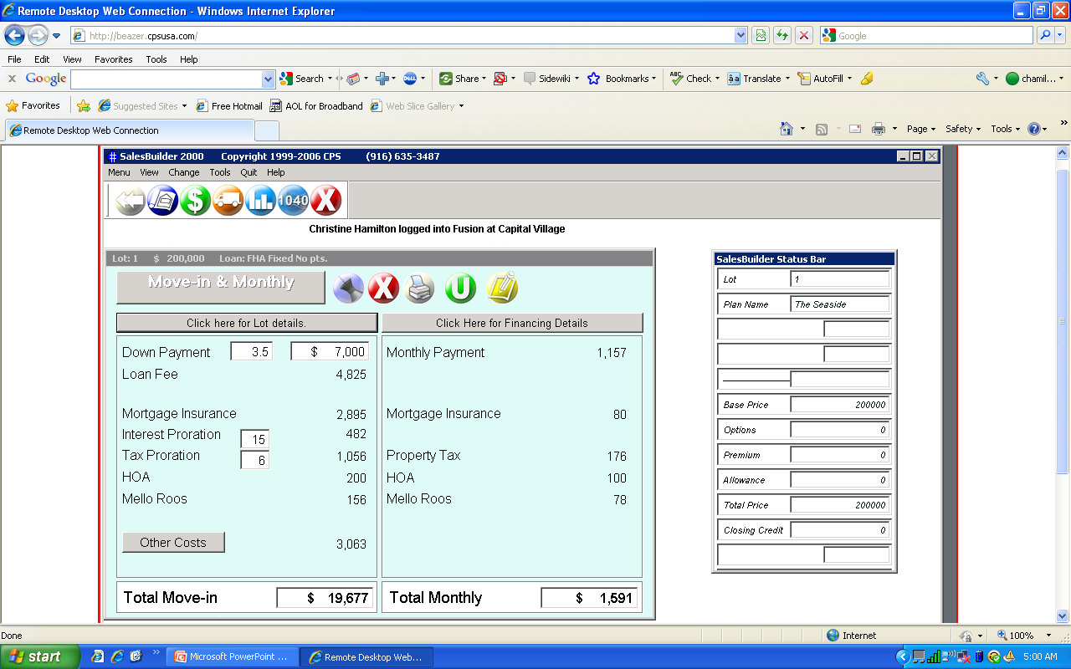
Notes:
How much do you have saved for your down payment and closing costs? Where is the money coming from? Do you have access to any gift funds? Where is the money located? Have they given you the money already? How much can you save per month toward your total move-in? How do you feel about these payments? What are you paying now in rent/mortgage?

Slide 10
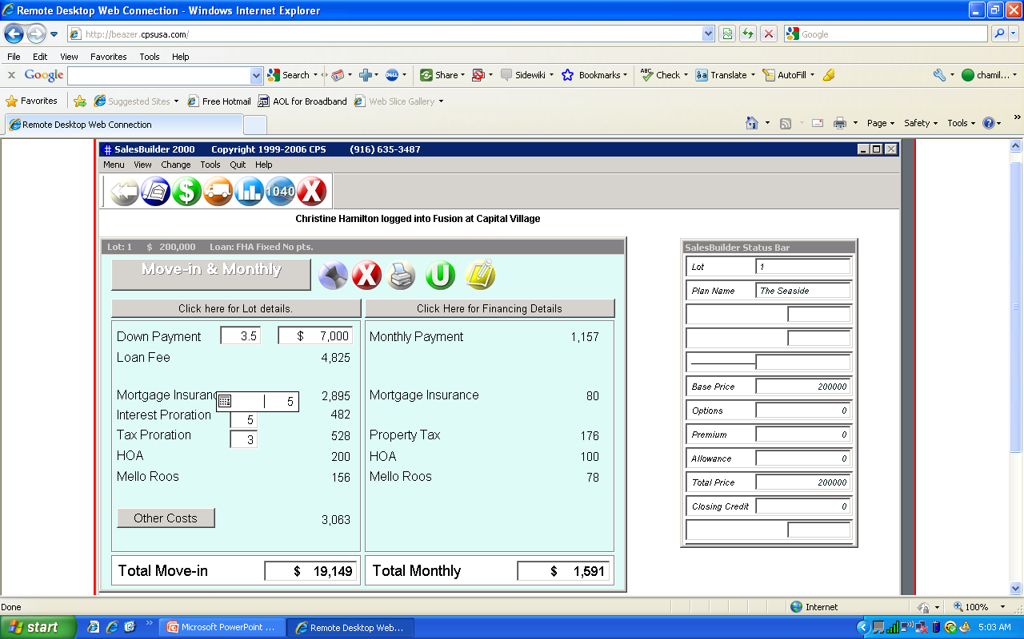

Slide 11


Slide 12
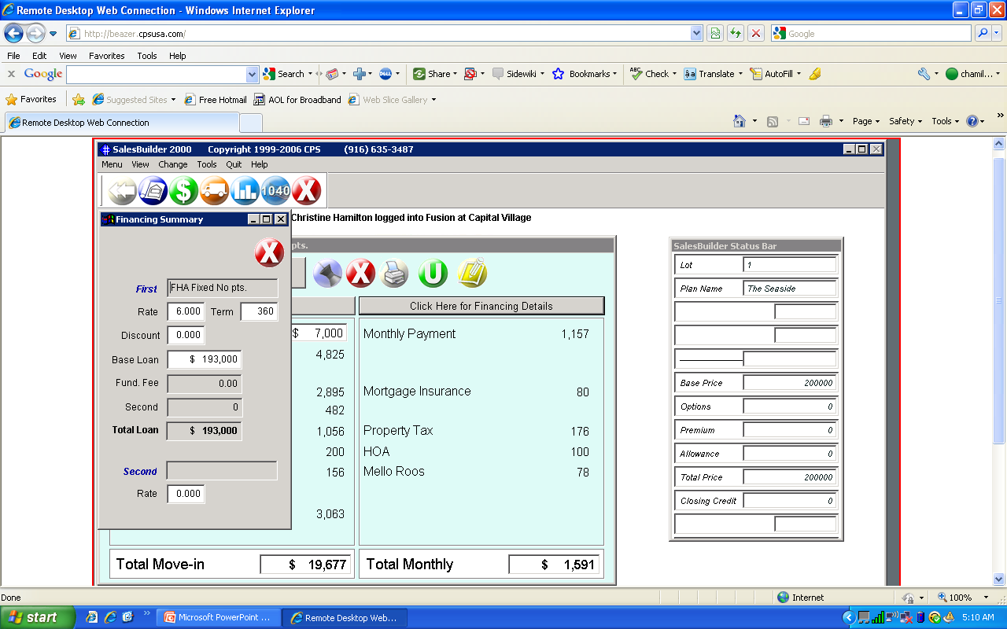

Slide 13
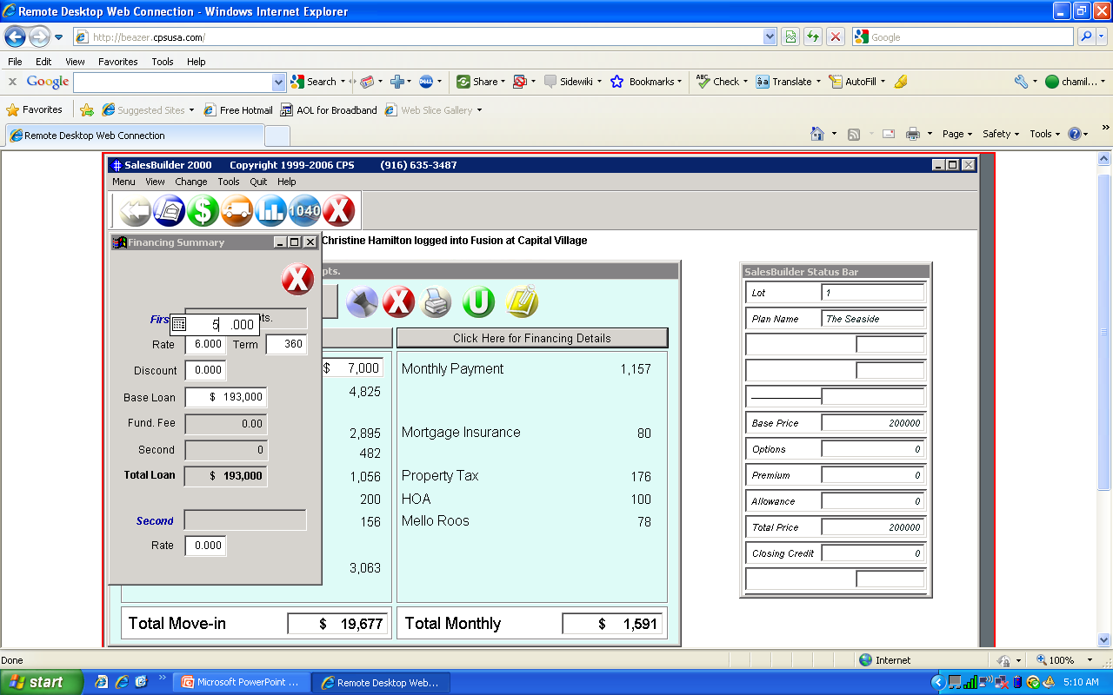

Slide 14
Notes:
On Left Hand side of the Move-in & Monthly Screen Click on grey bar for Financing Details. This is where you can adjust the interest rate. Notice grey box financing summary pops up. Click on the rate and enter new rate. Close the box.

Slide 15
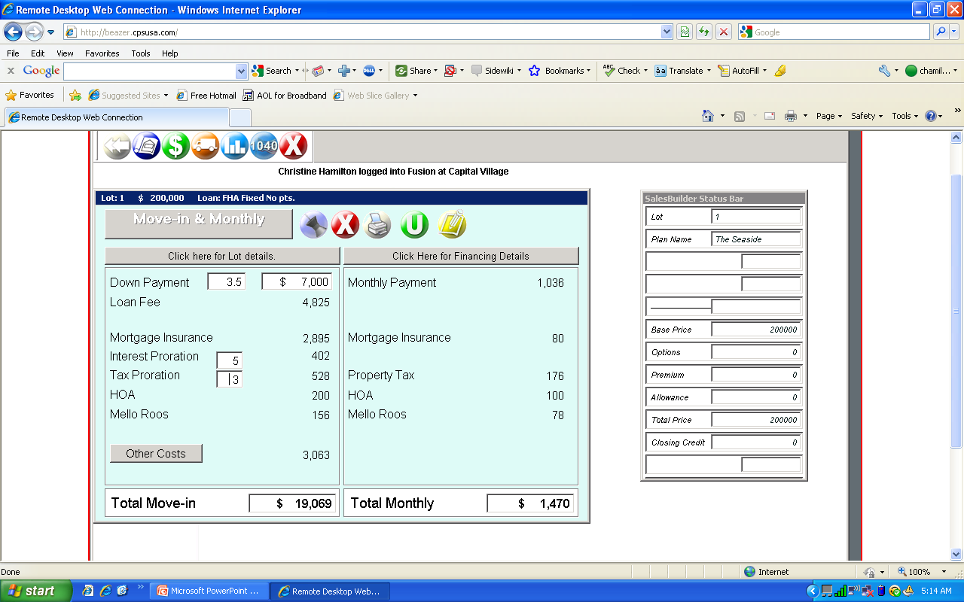
Notes:
Move-in and monthly screen at 5% interest rate. Notice that total Monthly payments are now at $1,470

Slide 16
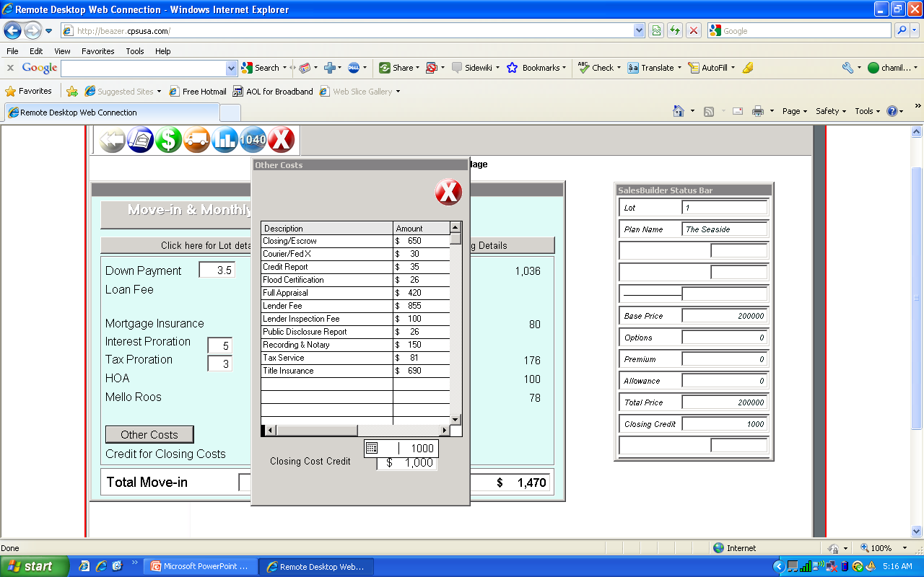
Notes:
Break down of misc fees, title, escrow, tax service, appraisal, title insurance. This is where we include any builder credits for closing costs. Best practice to include some seller paid closing cost for using your lender. Best way to control the loan process and have full communication with the lender, know buyer has a lender that will perform on time and knows your homes, system, expectations, etc.

Slide 17
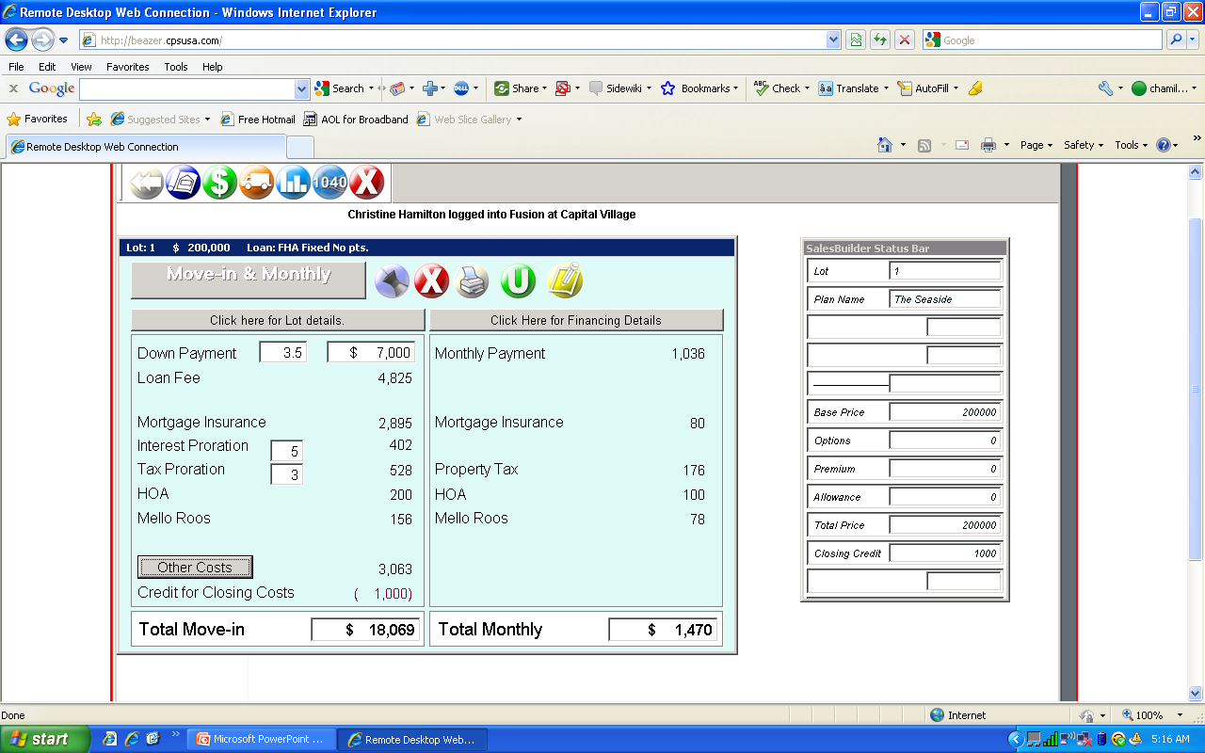
Notes:
Notice Total Move-in Decreases to $ And on the right hand side the cc credit now shows at the bottom of the box

Slide 18
Provide Printed Handouts
Insert slide of Move-in and Monthly Printout with Breakdown of fees.
Notes:
Now I will go over this print out just as I would with a buyer and explain all of the costs involved in purchasing the home today. See how simple and easy this is to understand? Now, let’s compare it to a lenders GFE on the next slide…. Notice the Move-in and Monthly amounts are pretty much the same!

Slide 19
Compare to Good Faith Estimate
Insert slide of lender’s GFE for comparison
Notes:
This is what a lender’s GFE look like. They are relatively complicated to understand. Versus see the next slide…

Slide 20
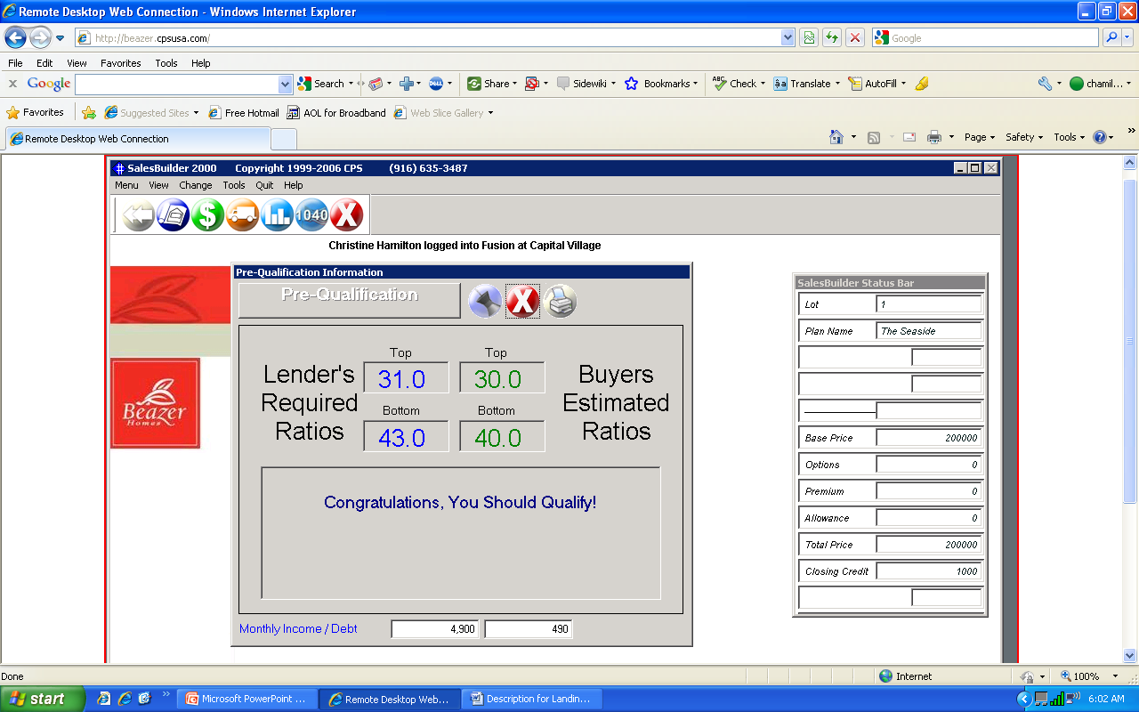
Notes:
So now I click on the drop down Menu for Qualification or the Blue dot icon with the bar graph. Here I input the buyer’s monthly income and their debts. Qualify in questions: What is your annual income? Are you salaried? Are you commissioned, do you receive any bonuses? Do you have a paystub on you? Are you paid every two weeks, bi-monthly, or monthly? Do you receive any child support or alimony? Do you own a business? If so, what was your net income, after taxes and expenses last year and the year before?
What are your debts per month? Do you have a car payment? What are your minimum monthly payments on your credit cards? Not what you actually pay, not what you own, just the minimums. Do you pay child support or alimony? Do you have any other credit related expenses? Phone bills and utilities don’t count.
Last, ask how’s your credit? Do you know your Fico scores? What are they? Have you had any late payments over 30 days in the last two years? Have you ever had a BK, foreclosure, short sale, liens, or repos?

Slide 21
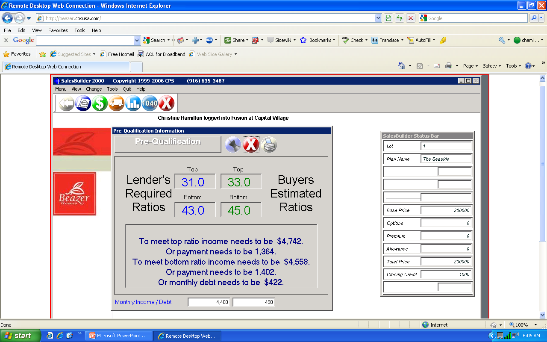
Notes:
Now let’s consider a scenario where our buyer seems less than stellar. All I did here was drop the buyers income to $4,400 per month. Notice now that the ratios have changed to 33/45 and the computer no longer says that they can qualify. But they are close! Question is do you write them if they are willing to complete a purchase agreement today? The answer is absolutely “YES”. Why do I say this? First, this is just an estimate. Until someone actually reviews pay stubs, credit card statements and pulls a credit report, you don’t know for sure. Their debts may actually come up less than they thought. If less than 10 months are owed on a car for example, you don’t have to count the payment. Likewise, their income may be higher than they calculated. These ratios are really close. Chances are a good lender can get them qualified. At this point, I would also ask if there is the possibility of a co-borrower. You must look for all possibilities. Additionally, a slight adjustment in the interest rate would also be a solution. Buyer, Builder, or Gifter may be willing to assist with closing costs and pay points to reduce the interest rate. Next, let’s determine the tax benefits of homeownership.

Slide 22
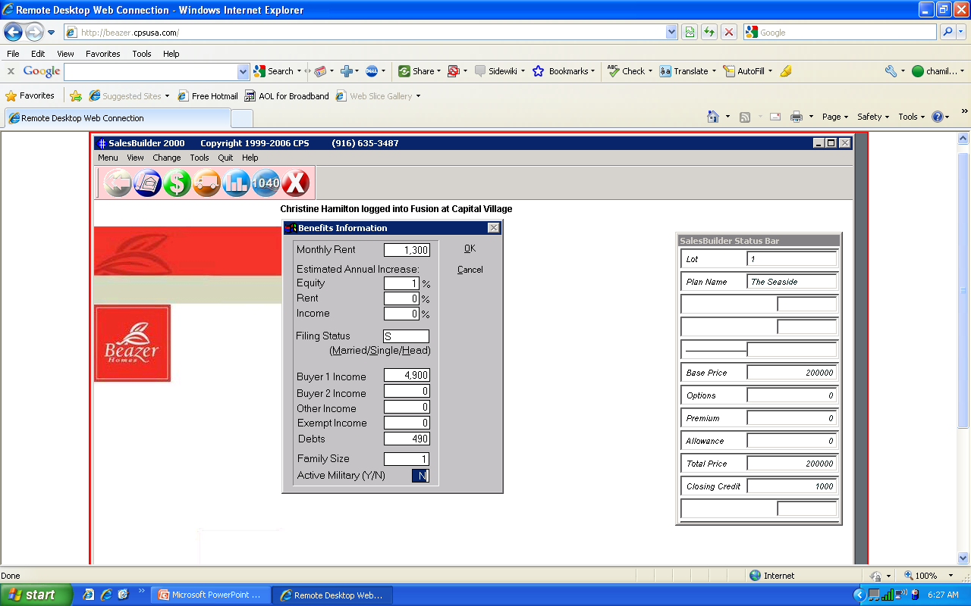
Notes:
On this slide I clicked on Qualification from the drop down menu. This is where I ask the buyer how much they are paying a month in rent. I assumed a modest 1% annual increase in the equity of the home. 0% increase in rents, 0% increase in come. Of course, for every scenario I could run the higher the percentages the better the tax benefits would seem but I want to be as realistic as I can for our example. We are assuming our buyer is Single and the program automatically inputs the buyers income and debts. I put in a family size of 1 and No for Active Military. The next screen will show us the tax benefits of homeownership.

Slide 23
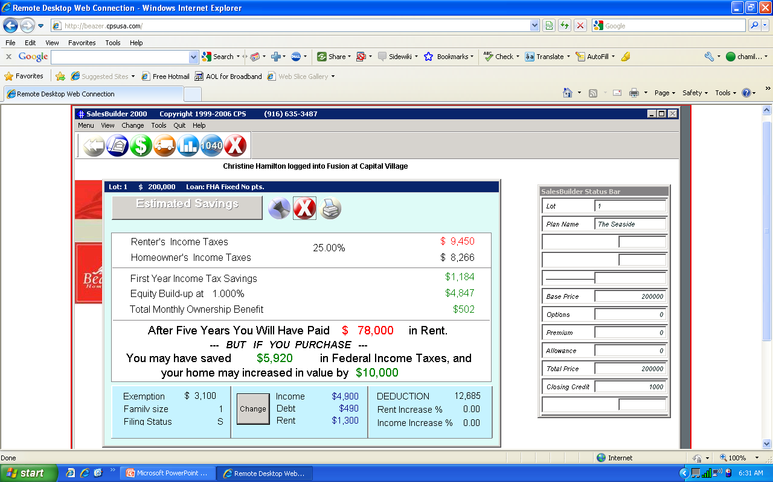
Notes:
Again, I want to point out that these are all estimates. But if the sales representative uses relatively realistic assumptions, the estimates are pretty accurate. At this point, I point out to the buyer the First Year Income Tax Savings in green on the right hand side. $1,,184 is pretty much $100 per month. So in our example, it makes more sense to own than rent. This screen is great for buyers who are the more analytical types, who need information to justify their emotional purchase with logic. To drive the point further, notice the $78,000 someone will have paid in rent over five years. Show them what a was of money that is!!! No matter what rent is a waste of money even if the mortgage payment is a lot higher than their rent.

Slide 24
Let’s Talk CONV Loans
680 FICO score
5% minimum down payment
2 months reserves
33/38 guidelines max 41 on backend
No gift
Seller can pay up to 3% non-recurring closing costs
No upfront mortgage insurance (MI)
.94 monthly MI w/ 5%
.62 monthly MI w/10%
No monthly MI w/20%+ down
Not assumable
No non-occupying co-borrowers

Slide 25
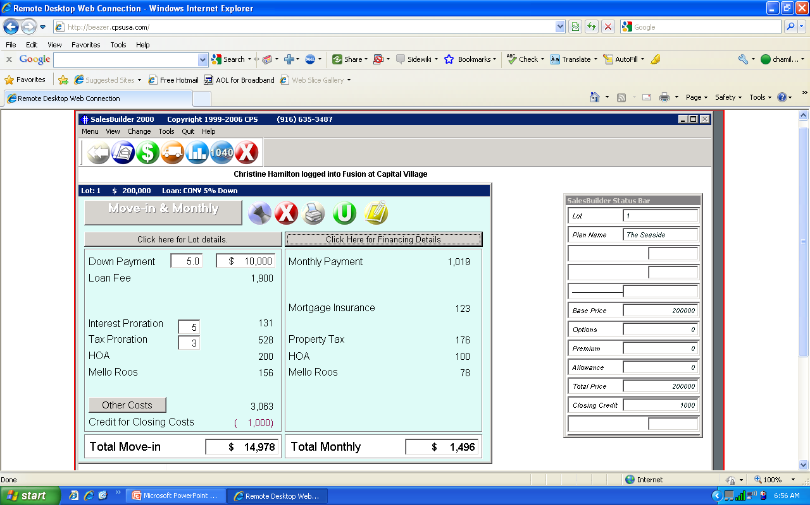
Notes:
Now let’s look at a CONV Loan compared to a FHA loan. Move in & Monthly. Next we’ll consider their ability to qualify.

Slide 26
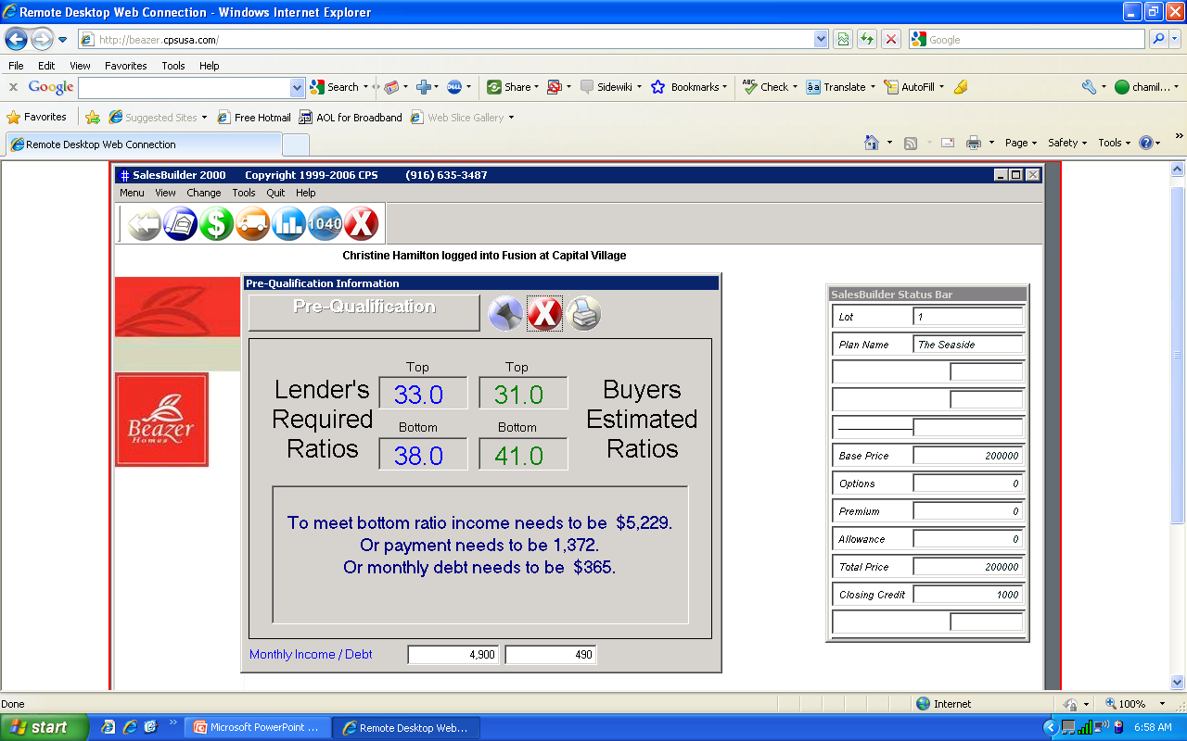

Slide 27
Insert slide of Move-in and Monthly for CONV with breakdown of Misc fees.

Slide 28
Loan Comparison w/Buyer
Next put the FHA and the
Conv side by side.
Notes:
Even putting two different loans scenarios side by side for comparison for the buyer if a great way to educate them. Educating them makes them feel more comfortable with a “YES” buying decision. Different characteristics of the loans. FHA Upfront MI fee. Lower monthly MI, Conv, no upfront MI, but higher on monthly basis. Easier to qualify for FHA loan, permits higher debt/income rations, buyer may also have gifted funds or a non-occupying co-borrow. Conv doesn’t allow for this. Next, you make your recommendation. Tell them chances are they should probably obtain an FHA loan.

Slide 29
Let’s Talk VA loans
620 FICO scores
Seller can pay up to 4% for buyer’s + non-reoccuring closing costs (including pay off debt!)
A VA loan can be assumed by anyone -- veteran or not
No monthly MI in the payments
620 FICO score
31/43 ratios; but can be pushed to 50% on the back end ratio

Slide 30
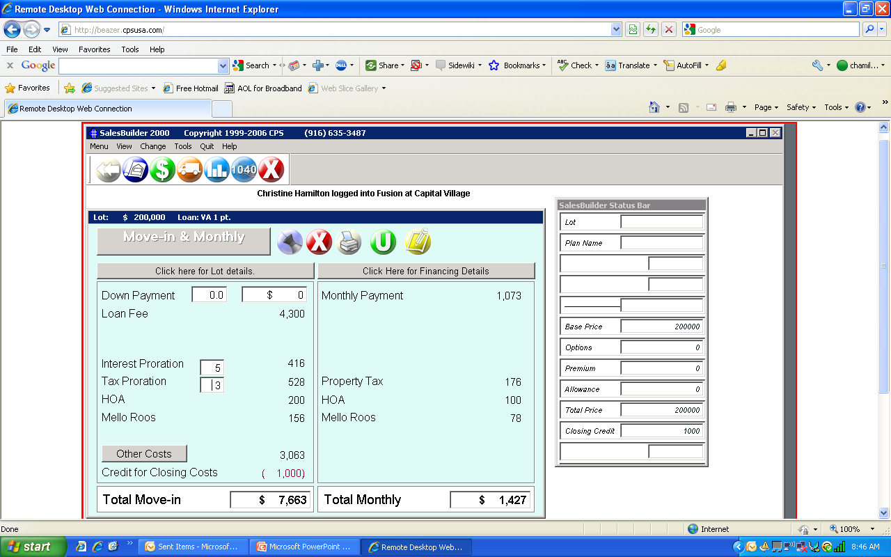
Notes:
Here’s I we discuss VA financing. Note: I used a VA loan for a first time user. If a VET is a 2nd time user, a disabled vet, a veteren of the national guard the VA FF is a different percentage rate. Notice up on the tool bar there is the option to CHANGE after Menu, View then Change. I just clicked on that and which type of VET they are. So before you show this financing scenario the questions to ask are have you used your VA eligibility previously? Do you have your DD-214 which are the vet’s discharge papers that show whether or not they were discharged honorably. If they had a dishonorable discharge then chances are they are not eligible for a VA loan. Second, ask which branch of the military they were in? Finally, ask if the happen to have their Certificate of Eligibility? If not, you will know that some additional time will be needed for their escrow in order for the lender to help them obtain that documentation. Overall, if a customer has VA eligibility, they want to go with this type of financing because there is no mortgage insurance charged in the monthly payments. However, there is a significant FF that is charged upfront. For a VA loan a seller can pay up to 4% of the closing costs and the VET can move-in for next to nothing.

Slide 31
Time to CLOSE the SALE!
What do you think about what I’ve shown you?
Which loan do you think is best for you?
Do you want to go ahead with it today?

Slide 32
Benefits of being able to Talk Money!
You have discussed the characteristics of FHA, VA and CONV loans with your buyer
Determine the buyer’s debt to income ratios
Demonstrate the tax benefits of home ownership
Reduce dependency on outside lenders
Close for the SALE TODAY!

Slide 33
THANK YOU!

